Slide 1
1. Interface
Module -3

Slide 2
Unit 5- Interface
Fundamentals
Implementing interface
Using interface reference
Interface can be extended
Implementing multiple inheritance
Constants in interface
Interface can be extended
Nested interface
Final thoughts on interface

Slide 3
Basics
What is a concrete method?
A method that has body is called concrete method
Example:
void show() {
System.out.println(“Hello”);
}

Slide 4
Basics
What is a abstract method?
A method that has No body and ends with semicolon
Example:
abstract void show() ;

Slide 5
1. Interface: Fundamemntals
Why to use interface
to achieve fully abstraction.
to achieve multiple inheritance.
Syntax
In interface by default
All methods are : public & abstract
All variables are: public, static & final
interface InterfaceName {
// [public abstract] methods
// [public static final] variables
}

Slide 6
1. Interface: Fundamemntals
Can also be defined as :
interface Stack {
void push();
int pop();
int STACKSIZE= 3;
}
// default public and abstract
// default public and abstract
// default public, static and final

Slide 7
1. Interface: Fundamemntals
we can create reference to interface.
We cannot instantiate an interface.
interface Stack {
---
}
class Demo {
public static void main ( String [] args ) {
Stack mystack ; // reference allowed
mystack = new Stack() ; // not allowed.
}
}

Slide 8
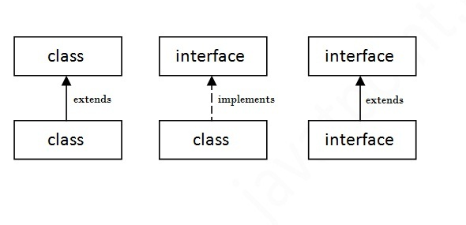
Relationship between classes and interface
class extends a class
class always implements an interface
Interfaces always extends an interfaces.
An interface cannot implement another interface or class.
Class cannot extend an interface

Slide 9
2. Implementing Interfaces:
Sub Class that implements interface
Subclass
must provide definition(body) to all abstract methods of a interface.

Slide 10
Unit 5- Interface
Fundamentals
Implementing interface
Using interface reference
Interface can be extended
Implementing multiple inheritance
Constants in interface
Interface can be extended
Nested interface
Final thoughts on interface

Slide 11
2. Implementing Interfaces:
Two ways of implementing interface
2.1. class implements interface
2.2. class extends other-class and implements interface

Slide 12
Example: Implementing Interfaces:
Example1
interface Stack {
void push( int item ) ;
int pop();
int MAX = 3;
}
class StackMaster implements Stack {
int top = -1;
public void push( int item ) {
// code
}
public int pop( ) {
// code
}
}

Slide 13
Example2: Implementing Interfaces:
// Applet is built-in class
interface Politician {
void speak();
}
class MyApplet extends Applet implements Politician {
public void speak() {
System.out.println (“Politician always speak for vote ..”);
}
}
Politician
Applet
MyApplet

Slide 14
Test yourself
Assume salary is an interface.
Which of the following is correct declaration of a class manager?
a) class Manager extends Salary {
---
---
}
b) class Manager imports Salary {
---
---
}
c) class Manager implements Salary {
---
---
}
d) class Manager inherit Salary {
---
---
}

Slide 15
Test yourself
Can we create non static variable in interface?
What will happen if we not initialize variables in an interface?
Can we create object for an interface?
How to access interface variable?
Interface.variable

Slide 16
Unit 5- Interface
Fundamentals
Implementing interface
Using interface reference
Interface can be extended
Implementing multiple inheritance
Constants in interface
Interface can be extended
Nested interface
Final thoughts on interface

Slide 17
3. Program : using interface reference
in Hierarchical inheritance, use of interface reference helps to achieve
run-time polymorphism.
Interface Shape
abstract method void getArea()
Rectangle class
constructor to set length and width
implement above interface
Square class
constructor to set side of Square
implement above interface
Demo class
main() method : calls getArea() for both class
interface: Shape
implements
class: Rectangle
class: Square
Hierarchical inheritance

Slide 18
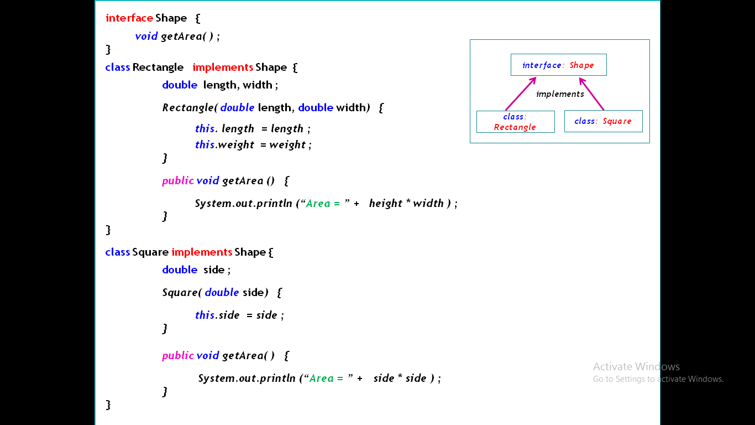
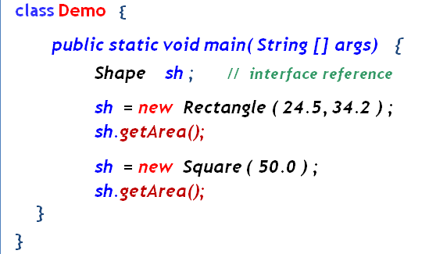
interface: Shape
implements
Rectangle
Square
// Create interface reference
// allocate memory of Rectangle
call getArea()
// allocate memory of Square
call getArea()

Slide 19
3. Program : using interface reference
Interface cannot be instantiated.
But we can declare a reference of an interface type.
Interface references are used to refer to objects of types that implement the interface.

Slide 20
Unit 5- Interface
Fundamentals
Implementing interface
Using interface reference
Interface can be extended
Implementing multiple inheritance
Constants in interface
Nested interface
Final thoughts on interface

Slide 21
4. Example: interface extends interface
An interface can extend another interface.
extends keyword is used so that child interface inherits the methods of the parent interface.
Example: implement following structure
Shape Interface
setName(name) - abstract method
Colorshape Interface
setColor(color) - abstract method
Rectangle class
Implement the interface
display() method - shows name and color
main() method – calls all these methods
All interface methods must be public
interface: Shape
extends
interface: ColorShape
implements
class: Rectangle

Slide 22
interface Shape {
void setName ( String name ) ;
}
interface ColorShape extends Shape {
void setColor ( String color) ;
}
class Rectangle implements ColorShape {
String name, color ;
void setName( String name) {
this.name = name ;
}
public void setColor ( String color) {
this.color = color ;
}
public void display ( String color) {
System.out.println (“Shape Name = ” + name ) ;
System.out.println (“Shape Color = ” + color ) ;
}
public static void main ( String [] args) {
Rectangle rect = new Rectangle();
rect.setName(“Ractangle”);
rect.setColor(“Red”);
rect.display();
}
}
interface: Shape
extends
interface: ColorShape
implements
class: Rectangle
Multi Level inheritance

Slide 23
Unit 5- Interface
Fundamentals
Implementing interface
Using interface reference
Interface can be extended
Implementing multiple inheritance
Constants in interface
Nested interface
Final thoughts on interface

Slide 24
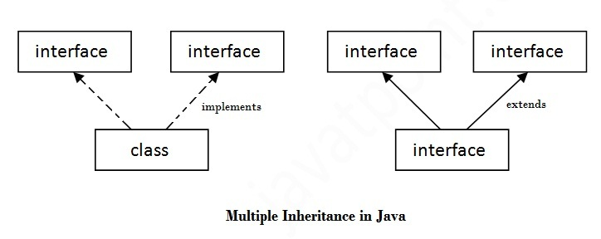
5. Implementing multiple inheritance
Multiple inheritance can be achieved in following situation
5.1. class implements more than one interface
5.2 . An interface extends more than one interface

Slide 25
5. Syntax: Multiple inheritance
5.1. class implements more than one interface
class ClassName implements interface1, interface2 {
// code
}
5.2 . An interface extends more than one interface
interface InterfaceName extends interface1, interface2 {
// code
}

Slide 26
5.1. Example: class implements more than one interface
Lab Example:
Implement Multiple inheritance using interfaces to calculate the area of a rectangle and triangle
Rectangle Interface has methods
areaRect()
Triangle Interface has methods
areaTriangle()
Shape class implements both interfaces
Implements all methods
Includes main to implement structure
All interface methods must be public
Interface
Interface
Rectangle
Triangle
implements
class: Shape

Slide 27
interface Rectangle {
void areaRect ( double height, double weight ) ;
}
interface Triangle {
void areaTriangle ( double height, double base ) ;
}
class Shape implements Rectangle, Triangle {
public void areaRect ( double height, double weight) {
System.out.println (“Rectangle Area = ” + height * weidth ) ;
}
public void areaTriangle ( double height, double base) {
System.out.println (“Triangle area = ” + 0.5 * height * base ) ;
}
public static void main ( String [] args) {
Shape sh = new Shape();
sh.areaRect ( 20, 30 );
sh.areaTriangle ( 40, 20 );
}
}
Interface
Interface
Rectangle
Triangle
implements
class: Shape
Multiple inheritance

Slide 28
5.2. interface extends more than one interface
5.2. Example: implement following structure
Rectangle Interface has method
areaRectangle()
Triangle Interface has method
areaTriangle()
Box interface extends both interfaces
showName(String)
Shape class
Implement the Box interface
main method to demonstrate
All interface methods must be public
Interface Rectangle
Interface Triangle
extends
Interface
Box

Slide 29
interface Rectangle {
void areaRect ( double height, double weight ) ;
}
interface Triangle {
void areaTriangle ( double height, double base ) ;
}
interface Box extends Rectangle, Triangle {
void showName( String name) ;
}
class Shape implements Box {
public void areaRect ( double height, double weight) {
System.out.println (“Rectangle Area = ” + height * weidth ) ;
}
public void areaTriangle ( double height, double base) {
System.out.println (“Triangle area = ” + 0.5 * height * base ) ;
}
public void showName ( String name) {
System.out.println (“Shape Name = ” + name ) ;
}
public static void main ( String [] args) {
Shape sh = new Shape();
sh.setName(“Ractangle”);
sh.areaRect ( 20, 30 );
sh.setName (“Triangle”);
sh.areaTriangle ( 40, 20 );
}
}
Interface
Interface
Rectangle
Triangle
extends
Box
Interface
Multiple inheritance

Slide 30
Unit 5- Interface
Fundamentals
Implementing interface
Using interface reference
Interface can be extended
Implementing multiple inheritance
Constants in interface
Nested interface
Final thoughts on interface

Slide 31
Constants in interface
syntax:
Variable must be assigned a fixed value
All variables are by default static and final
interface InterfaceName {
[static] [final] Datatype variableName = fixedvalue ;
}

Slide 32
Example1: Constants in interface
Example1:
interface Stack {
void push( int item) ;
int pop () ;
int stackSize= 3 ; // constants in interface
}

Slide 33
Example2: Constants in interface
interface Medals {
public static String medal1 = “Gold” ;
public static String medal2 = “Silver” ;
public static String medal3 = “Bronze” ;
}
class Sports implements Medals {
public static void main(String [] args) {
System.out.println (“First medal = ” + medal1 );
}
}

Slide 34
Unit 5- Interface
Fundamentals
Implementing interface
Using interface reference
Interface can be extended
Implementing multiple inheritance
Constants in interface
Nested interface
Final thoughts on interface

Slide 35
Nested interface
Syntax1: Nested interface within interface
Syntax2: Nested interface within class
interface Interface1 {
- - - - - - - -
interface Interface2 {
- - - - -
}
}
class ClassName {
- - - - - - - -
interface Interface {
- - - - -
}
}

Slide 36
Nested interface
Nested interface is declared within another interface or class.
Nested interfaces are used to group related interfaces. Easy to maintain.
The nested interface must be referred by the outer interface or class. It can't be accessed directly.
Nested interfaces are implicitly static and public.

Slide 37
Example: Nested interface
interface Image {
void showName();
interface Circle { // Nested interface
void areaCircle ( int rad );
}
}
Nested interface is referred by the outer interface or class.
It can't be accessed directly.
class NestedCircle implements Image.Circle {
public void areaCircle( int rad ) {
System.out.println (“Area = ” + (3.14 * rad * rad )) ;
}
}
public class Demo {
public static void main( String[] args) {
NestedDemo dx = new NestedDemo();
dx.areaCircle(4);
}
}

Slide 38
Restrictions of interfaces
If a sub-class does not implemented one of the abstract method of interface then,
compiler generates an error.
Such a subclass need to be defined as abstract class.
If subclass method tries to modify the interface variable, then
compiler will generate an error.

Slide 39
Restrictions of interfaces
When one of the abstract method of interface is not implemented in the sub-class, compiler generates an error.
interface Stack {
void push( int item ) ;
int pop();
int MAX = 3;
}
class StackMaster implements Stack {
int top = -1;
void push( int item ) {
// code
}
// method pop() not defined. Compiler generates error
}

Slide 40
Restrictions of interfaces
When one of the abstract method of interface is not implemented in the sub-class, compiler generates an error.
interface Stack {
void push( int item ) ;
int pop();
int MAX = 3;
}
class StackMaster implements Stack {
int top = -1;
void push( int item ) {
// code
}
// method pop() not defined. Compiler generates error
}

Slide 41
Restrictions of interfaces
When one of the abstract method of interface is not implemented in the sub-class, compiler generates an error.
interface Stack {
void push( int item ) ;
int pop();
int MAX = 3;
}
abstract class StackMaster implements Stack {
int top = -1;
void push( int item ) {
// code
}
// method pop() not defined. No error
}
add

Slide 42
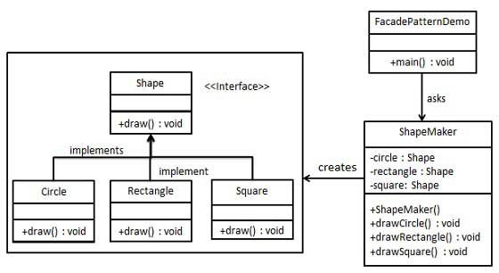
implement class diagram

Slide 43
implement class diagram
public interface Shape {
void draw();
}
public class ShapeMaker {
private Shape circle;
private Shape rectangle;
private Shape square;
public ShapeMaker() {
circle = new Circle();
rectangle = new Rectangle();
square = new Square();
}
public void drawCircle(){
circle.draw();
}
public void drawRectangle(){
rectangle.draw();
}
public void drawSquare(){
square.draw();
}
}
public class Rectangle implements Shape {
public void draw() { System.out.println("Rectangle::draw()");
}
}
public class Square implements Shape {
public void draw() { System.out.println(“Square::draw()");
}
}
public class Circle implements Shape {
public void draw() { System.out.println(“Circle::draw()");
}
}
public class interfaceDemo {
public static void main(String[] args) {
ShapeMaker sh = new ShapeMaker();
sh.drawCircle();
sh.drawRectangle();
sh.drawSquare();
}
}

Slide 44
1. Interface: Fundamemntals
Why to use interface
to achieve fully abstraction.
to achieve multiple inheritance.
Why interface is not like a class
An interface does not contain any constructors.
All of the methods in an interface are abstract.
An interface cannot contain instance fields. They must be declared static and final.
An interface is implemented; not extended by a class.
An interface can extend multiple interfaces.

